Slide 1


PPT BY :
G. PRANAVI REDDY – 23BD1A052G

Slide 2
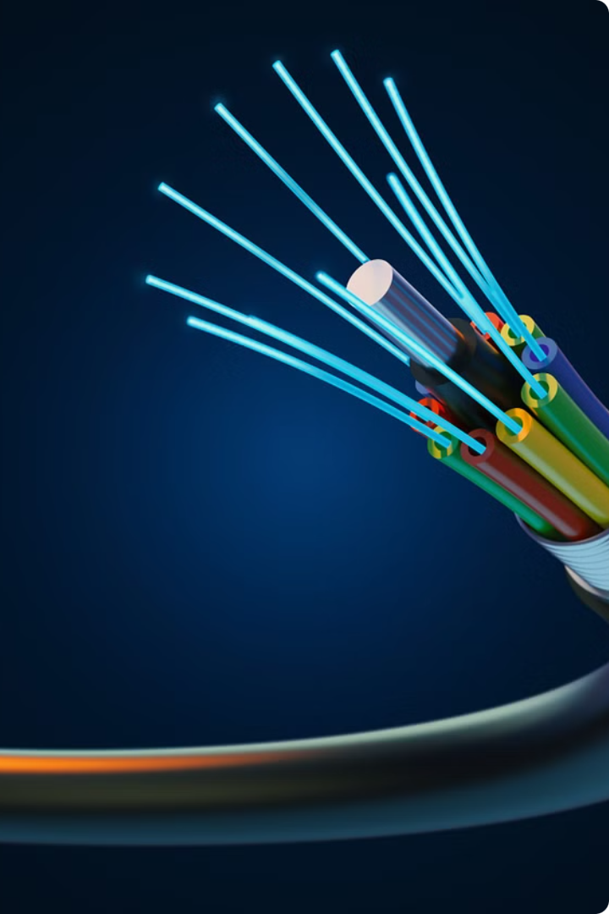
Introduction to Optical Fibers
Optical fibers are thin, flexible strands of glass or plastic that can transmit data in the form of light over long distances with minimal signal loss. These revolutionary communication cables underpin our modern digital world, powering high-speed internet, TV, and telecommunications.

Slide 3

What are Optical
Fibers?
Optical fibers are thin, flexible strands of transparent glass or plastic that are capable of transmitting light signals over long distances. They are the backbone of modern telecommunication networks, enabling high-speed internet, cable TV, and voice communications.
Optical fibers work by total internal reflection, guiding light through the core of the fiber with minimal loss or distortion. This allows for efficient and reliable data transmission compared to traditional copper wires.

Slide 4


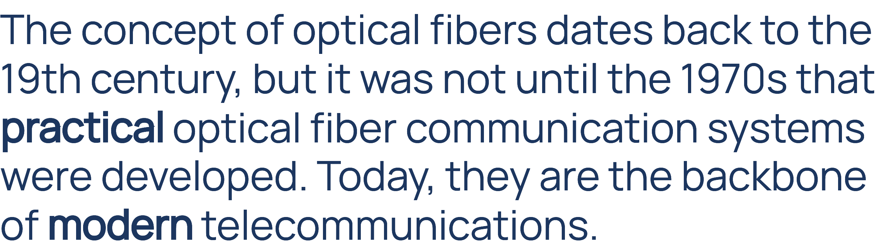

Slide 5

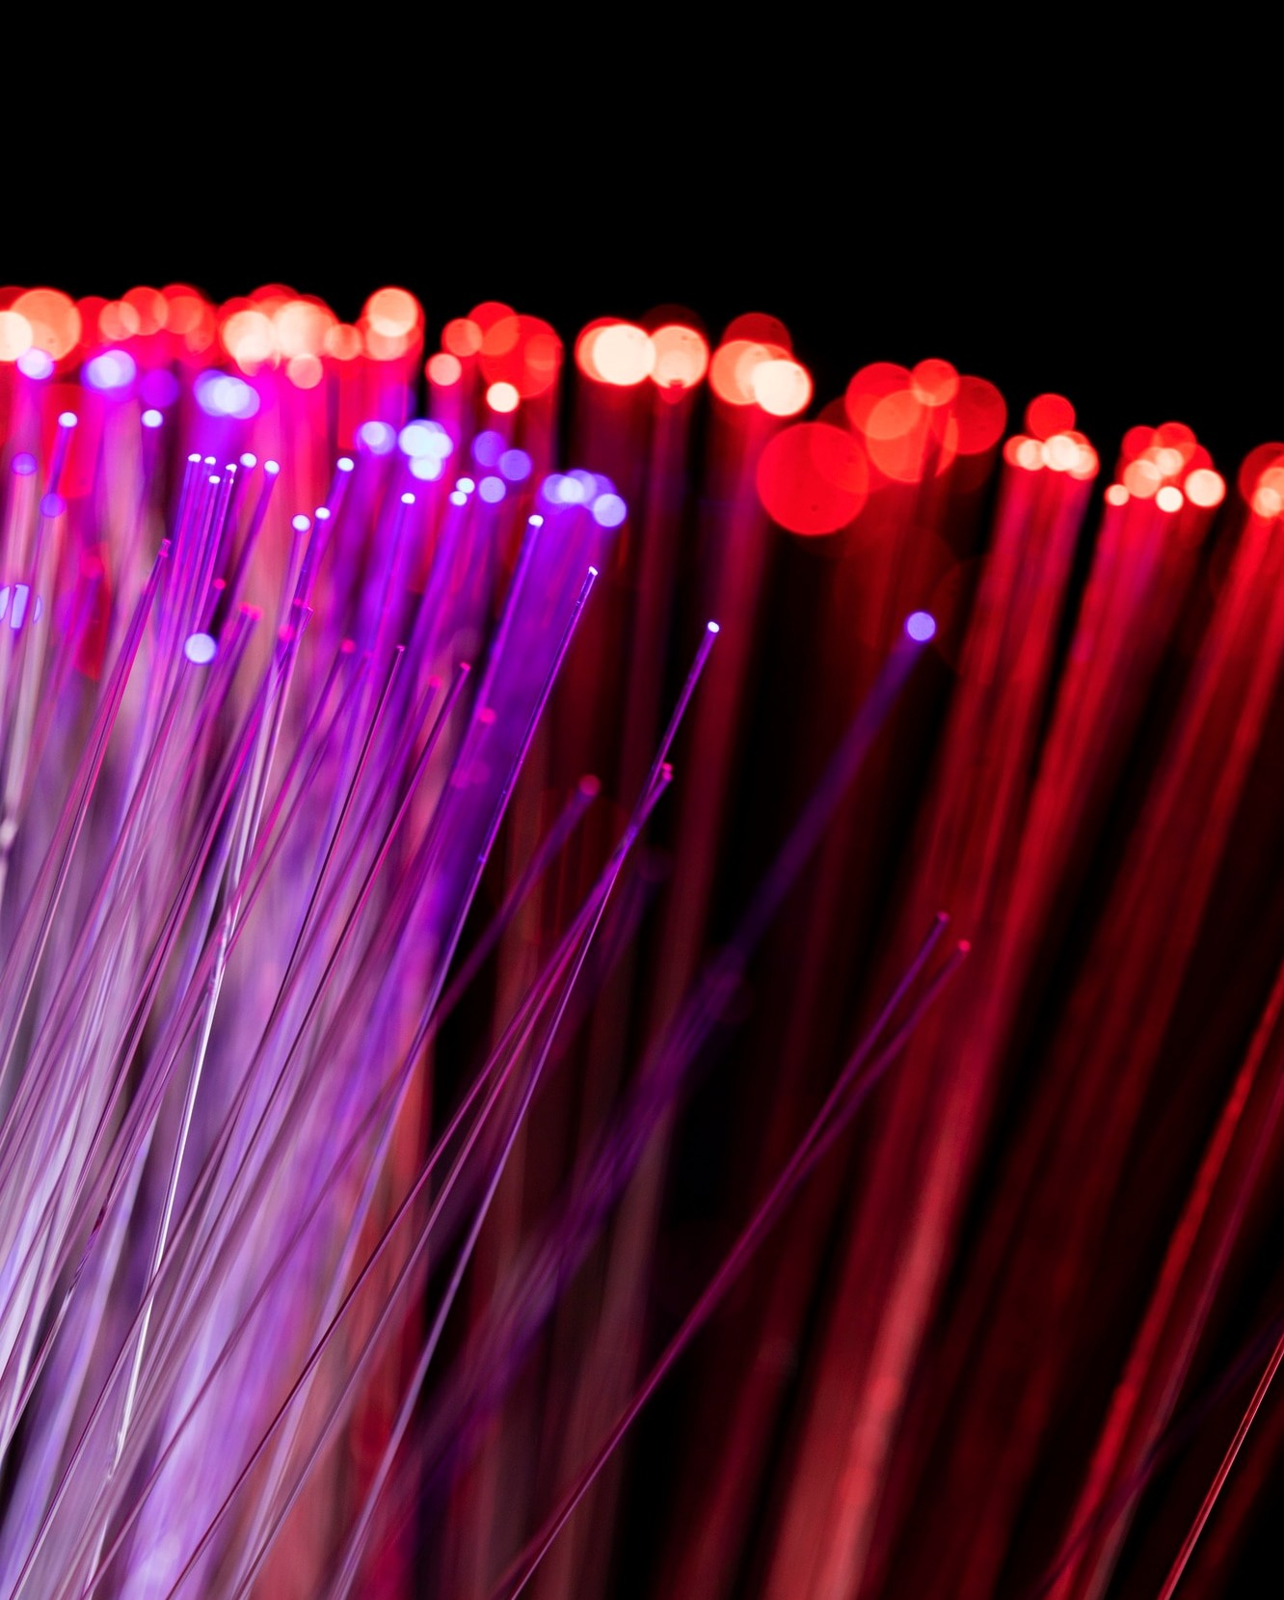


Slide 6
Advantages of Optical Fibers
High Bandwidth
Low Attenuation
Optical fibers can transmit vast amounts of data at lightning-fast speeds, enabling high-capacity communications and supporting the growing demand for bandwidth-intensive applications.
Signals transmitted through optical fibers experience minimal signal loss over long distances, reducing the need for frequent signal regeneration and amplification.
Immunity to Electromagnetic Interference
Enhanced Security
Optical fiber transmissions are inherently more secure, as it is difficult to tap into the fiber without being detected, providing a higher level of privacy and protection.
Optical fibers are not affected by electromagnetic interference, making them ideal for use in environments with high levels of electrical noise.

Slide 7
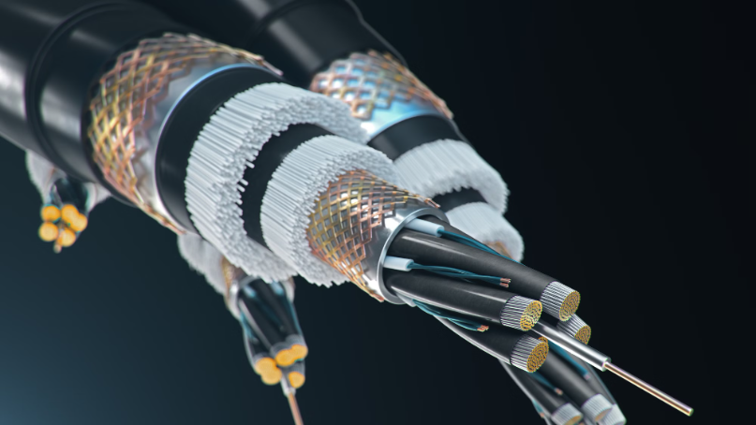
Optical Fiber Structure and Composition
Optical fibers are typically composed of three main components: the core, the cladding, and the protective coating. The core is the innermost part of the fiber, responsible for transmitting the light signals. The cladding surrounds the core, providing a barrier that helps confine the light within the core. The protective coating, usually made of plastic or resin, shields the fiber from environmental damage and mechanical stress.

Slide 8
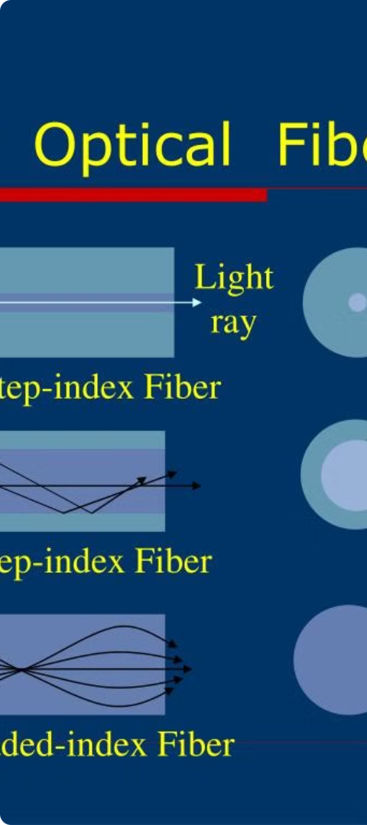
Optical Fiber Transmission Modes
1
Single-Mode Fiber
Transmits a single beam of light, enabling long-distance, high-bandwidth communications for telephone, internet, and TV signals.
2
Multi-Mode Fiber
Transmits multiple beams of light, typically used for shorter-distance applications like inside buildings or on campuses.
3
Graded-Index Fiber
Uses a refractive index that gradually decreases from the core to the cladding, reducing signal dispersion for higher bandwidth.

Slide 9
Optical Fiber Propagation Mechanisms
Total Internal Reflection
Modes of Propagation
Light travels through the fiber core by continuously reflecting off the core-cladding interface, a phenomenon known as total internal reflection.
Optical fibers can support multiple modes, or paths, for light to propagate, each with a distinct angle and velocity.
Dispersion
Attenuation
Different wavelengths and modes of light can travel at slightly different velocities, causing dispersion and signal distortion over long distances.
Light experiences gradual power loss as it travels through the fiber due to absorption, scattering, and other imperfections in the material.

Slide 10


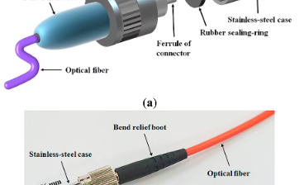
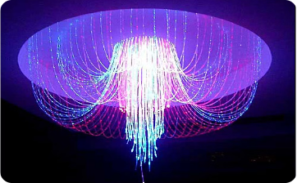
Optical Fiber Applications
Telecommunication
Medical Imaging
Sensing Applications
Specialty Lighting
Optical fibers are the backbone of modern telecommunications, enabling high-speed internet, telephone, and cable TV services across vast distances with unparalleled bandwidth and reliability.
Optical fibers are used in endoscopes and other medical imaging devices, allowing doctors to view hard-to-reach areas of the body with exceptional clarity and precision.
Optical fibers are used in decorative lighting applications, from architectural installations to automotive interiors, providing unique illumination effects and energy-efficient performance.
Optical fibers can act as highly sensitive sensors, detecting changes in temperature, pressure, strain, and other parameters, making them invaluable in industries like energy, manufacturing, and transportation.

Slide 11




Slide 12




Optical Fiber Installation and Maintenance
Planning
1
Careful site surveys and network design
2
Installation
Skilled technicians, specialized equipment, and safety protocols
3
Testing
Rigorous performance evaluation and validation
Maintenance
4
Proactive monitoring, rapid response, and preventative care
Deploying and maintaining optical fiber networks requires meticulous planning, precise installation, thorough testing, and ongoing maintenance. From initial site surveys to skilled technician teams, specialized equipment, and safety protocols, each step is critical to ensuring reliable, high-performance fiber optic connectivity. Regular testing and proactive monitoring help identify and resolve issues quickly, while preventative maintenance keeps the network operating at peak efficiency.

Slide 13
Optical Fiber Testing and Troubleshooting
Diagnostic Tools
Testing Procedures
Maintenance and Repair
Documentation
Optical time-domain reflectometers (OTDRs) are essential for monitoring fiber optic networks and troubleshooting issues. These advanced instruments can locate and identify faults, bends, and other problems along the fiber path.
Comprehensive testing protocols involve measuring optical power, attenuation, and dispersion at various points in the network. This data helps isolate the source of any performance degradation or disruptions.
Detailed records of test results, repair work, and network changes are critical for effective troubleshooting and future planning. Comprehensive documentation helps identify trends and proactively address potential problems.
When issues are detected, skilled technicians can perform splicing, re-termination, or other corrective actions to restore optimal fiber optic transmission. Proper maintenance and periodic testing ensures the long-term reliability of the network.

Slide 14

Future Developments in Optical Fiber Technology
As optical fiber technology continues to advance, future developments promise even faster data transmission, increased bandwidth, and enhanced reliability. Researchers are exploring novel materials, improved fabrication methods, and innovative fiber designs to push the boundaries of what's possible.
Key areas of focus include hollow-core fibers, photonic crystal fibers, and specialty fibers tailored for specific applications like sensing, high-power lasers, and quantum communications. Advances in inwill further expand the reach and impact of optical fiber networks.tegration with electronics and wireless technologies

Slide 15

